Slide 1



Slide 2
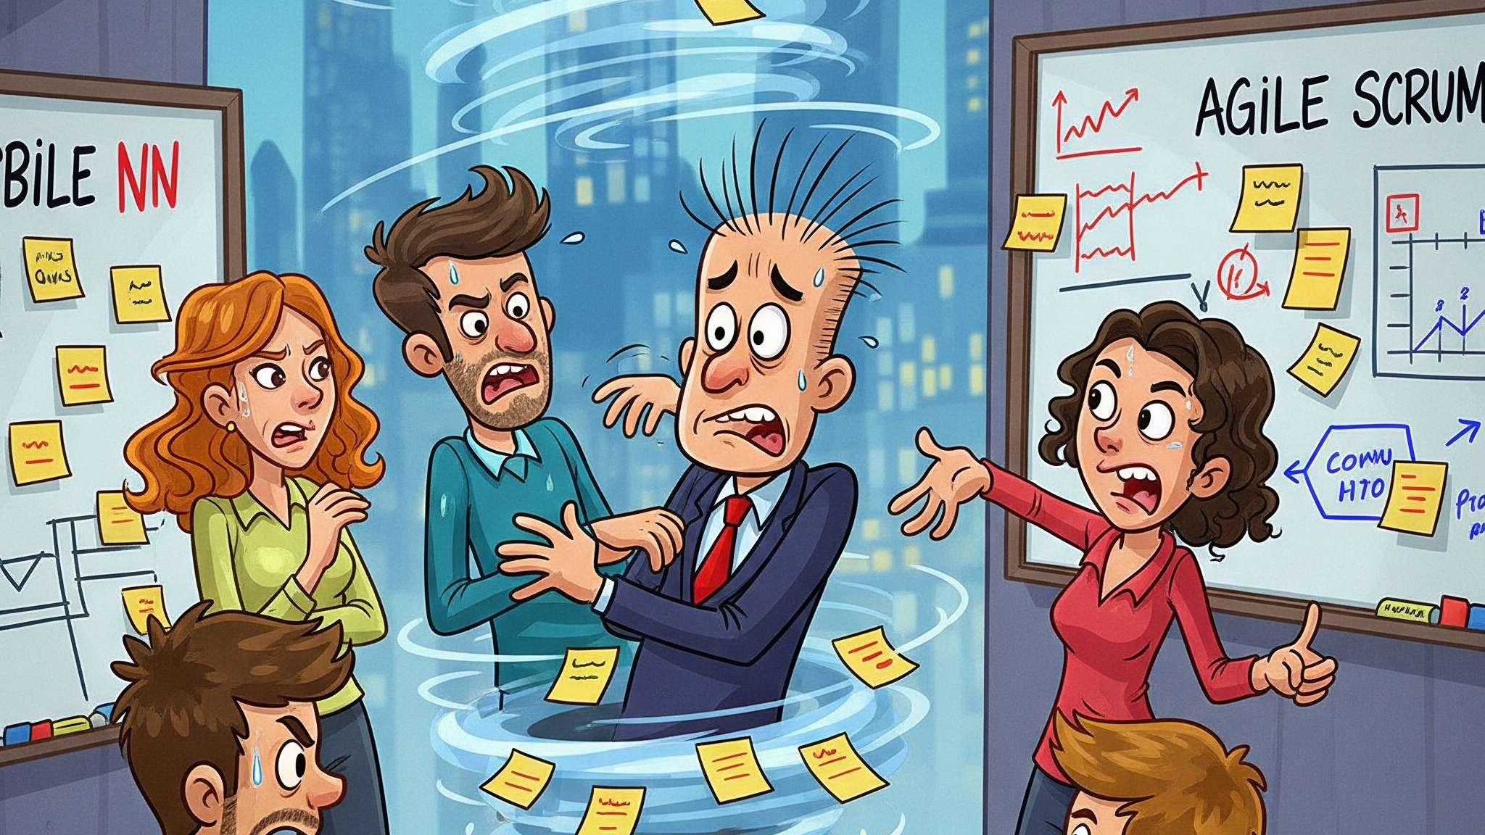

Slide 3
Your agile process transformed – no magic carpet needed
Evaluates
Recommends
Integrates
Visualizes
Ensures requirements are clear and follow AMA standards
Breaks down work items into smaller, actionable tasks
Seamless integration with Azure DevOps Boards
Powerful dashboard insights and analytics

Slide 4
Unlock a whole new world of Agile possibilities
Clarity
Cost Savings
Improved clarity and consistency with requirements
Agile teams save on average $65,000 per year
Efficiency
AI automation
Spend more time delivering value
Augment work with AI technology

Slide 5
Let’s build the future together
2025
2026
Epics & Features
Multi-Modal
Knowledge
Code
Support Epic and Feature level breakdowns
Support images and diagrams in work items
Enhance task generation with RAG technology
Add code suggestions from code base

